Slide 1
Waste Classification for Recycling Using CNN and Transfer Learning
PRESENTED BY
GUIDE
Keerthana G — 2520090132
Dr. Y. Lakshmi Prasanna
Sutte Alekhya — 2520090126
Assistant Professor, CS-IT
Notes:
Introduce the project title, team members, guide, department, university and academic year.

Slide 2
Introduction
Recycling only works when waste is sorted right
Background
The domain
Why it is needed
Urbanisation and changing consumption have increased the volume and variety of municipal solid waste. Separation is still mostly done by hand.
Computer vision lets CNNs learn edges, shapes and textures from images. Transfer learning reuses models trained on huge image sets for small datasets.
Manual sorting is slow and error-prone, so recyclable material often ends up in landfill. A one-click tool makes sorting faster and consistent.
Waste Classification · CNN & Transfer Learning
2
Notes:
Background, brief domain overview (computer vision, CNNs, transfer learning) and why the project is needed.

Slide 3



Problem statement
Mixed waste is sorted by hand
Slow and costly
Error-prone
Lost recyclables
Manual segregation is labour-intensive and time-consuming.
Different workers decide differently about the same item.
Plastic, paper, glass and metal mixed with organic waste are harder to recover.
WHO IS AFFECTED
Residential communities, recycling centres and their workers, municipal bodies and the environment.
Waste Classification · CNN & Transfer Learning
3
Notes:
Existing problem, its challenges, and who is affected. End with the central question of the case study.

Slide 4
Motivation
Why we chose this project
Our reason
Real-world need
Research motivation
It covers the full path from data to a usable app: a deep learning model, a REST API and a web front end, solving a visible everyday problem.
A low-cost tool anyone can use from a phone or computer: photograph an item and be told what type of waste it is.
TrashNet-style datasets made waste-image classification a known benchmark, and light pre-trained networks make deployment practical.
Waste Classification · CNN & Transfer Learning
4
Notes:
Why the project was selected, the real-world need and the research and industry motivation (TrashNet, Yang and Thung, Stanford CS229).

Slide 5
Objectives
What the project sets out to do
Main objective: identify the category of a waste item from a single photograph using a CNN with transfer learning, served through a web app.
1
Build a data pipeline for 7 classes: resize, normalise, augment, split.
2
Train and compare MobileNetV2, ResNet50 and EfficientNetB0.
3
Evaluate with accuracy, precision, recall, F1-score and confusion matrix.
4
Expose the trained model through a Flask REST API (/predict).
5
Build a web UI that uploads, previews and shows class and confidence.
Waste Classification · CNN & Transfer Learning
5
Notes:
State the main objective, then the five specific objectives. An optional SQLite history module is a bonus.

Slide 6
Existing system
Current approach
Technologies
Limitations
Workers recognise the material of every item and place it in the right bin, at the source or at the sorting facility.
Almost none in small communities and recycling centres. Automated sorting exists only in large industrial plants and is costly.
Slow and labour-intensive
Inconsistent decisions
Contaminated recyclables go to landfill
No easy way for the public to check an item
Waste Classification · CNN & Transfer Learning
6
Notes:
Describe the manual segregation process in the case-study scenario and why it falls short.

Slide 7
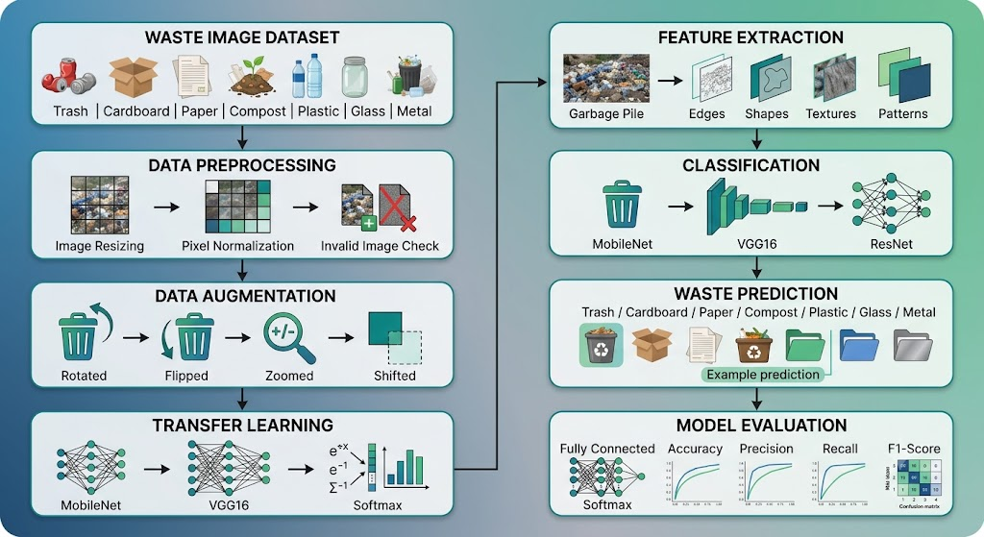
Proposed system
Upload a photo. A Flask API preprocesses it and a transfer-learning CNN returns the class and a confidence score.
Slow, costly → prediction in seconds
Inconsistent → one model, one standard
Lost recyclables → faster identification
Hard to access → works in any browser
Waste Classification · CNN & Transfer Learning
7
Notes:
Our solution and how each existing limitation is addressed. The diagram shows the pipeline from dataset to evaluation.

Slide 8
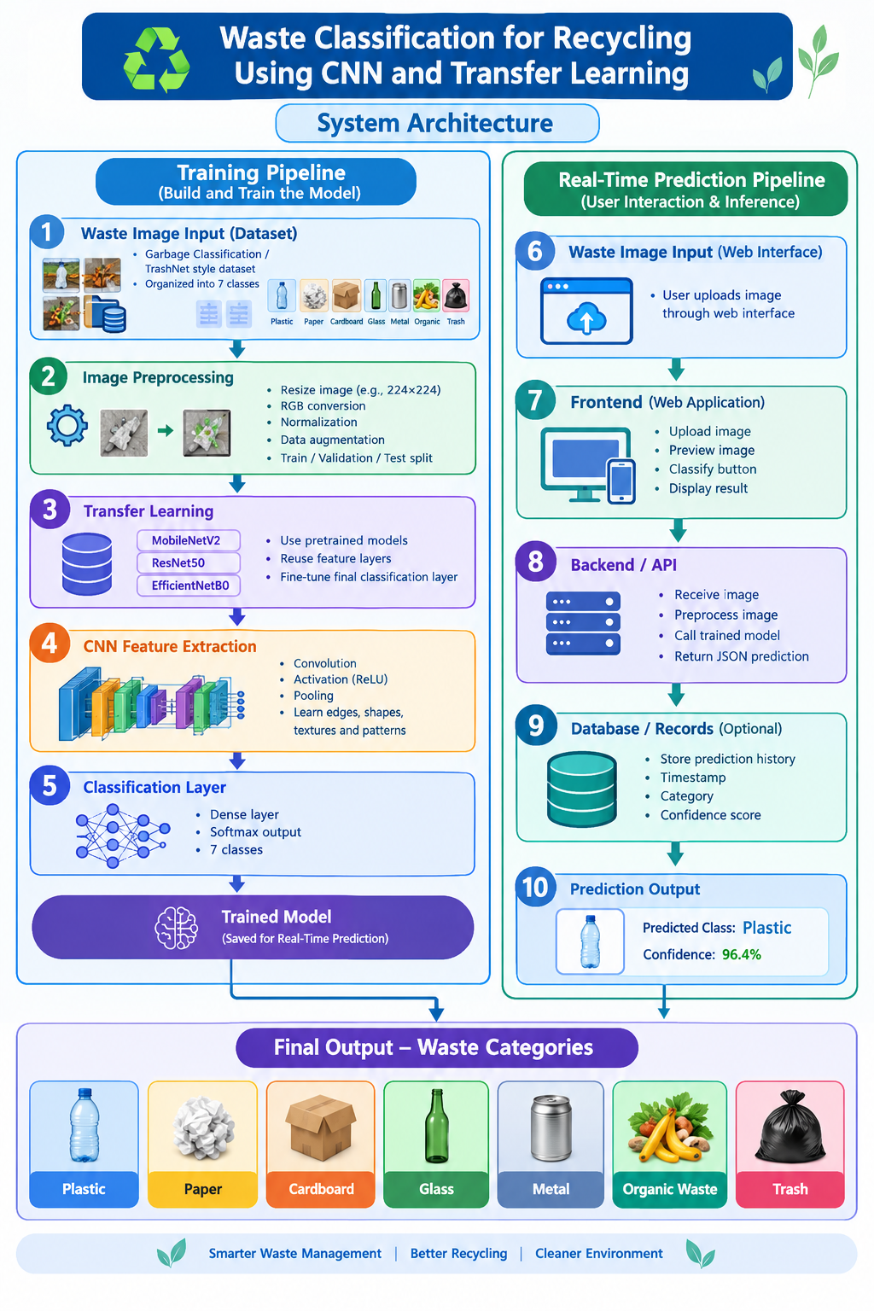
System architecture
INPUT
Photo of one waste item uploaded in the browser
PROCESSING / MODULES
Resize 224×224, RGB, normalise → Flask API → optional SQLite log
ALGORITHMS / MODELS
CNN + transfer learning: MobileNetV2, ResNet50, EfficientNetB0
OUTPUT
One of 7 classes with a confidence score, e.g. Plastic, 96.4%
Waste Classification · CNN & Transfer Learning
Notes:
Walk through the diagram: training pipeline on the left (dataset to saved model), real-time prediction pipeline on the right (web interface to predicted class).

Slide 9
Methodology
Nine steps from data to web app
01
02
03
Collect the dataset in 7 class folders
Run EDA: counts, bad files, sizes, samples
Preprocess and split into train, val, test
04
05
06
Augment: flip, rotate, zoom, shift
Attach a 7-class head to a pre-trained backbone
Train the head, then fine-tune the top layers
07
08
09
Evaluate on the unseen test set
Save the model and serve it with Flask
Connect the web front end
Waste Classification · CNN & Transfer Learning
9
Notes:
Step-by-step workflow. The pipeline diagram appears on the proposed system slide.

Slide 10
End-to-end workflow
What happens when a user clicks Classify
1 · User
2 · Frontend
3 · Backend
4 · CNN model
5 · Frontend
Selects an image
Previews, then sends it to the API
Resize 224×224, RGB, normalise
Predicts the class
Shows class and confidence
REQUEST
RESPONSE · 200 OK
POST /predict
{"class": "Plastic",
file: waste_image.jpg
"confidence": 0.964}
Waste Classification · CNN & Transfer Learning
10
Notes:
Runtime flow from user to result, with the API request and JSON response. The user sees the result in seconds.

Slide 11
Technology stack
Tools used at each layer
Layer | Technologies
Languages | Python · HTML5 · CSS3 · JavaScript
Frameworks | Flask REST API · TensorFlow / Keras
Libraries | Pillow · NumPy · scikit-learn · Matplotlib · Fetch API
ML models | MobileNetV2 · ResNet50 · EfficientNetB0 (.keras / .h5)
Database | SQLite (optional): timestamp, category, confidence
Hardware | Standard CPU server, no special hardware needed
Waste Classification · CNN & Transfer Learning
11
Notes:
Languages, frameworks, libraries, model files, database and hardware. Add GPU or Colab here if you trained on one.

Slide 12
System modules
Eight components working together
User interface
Data collection
Preprocessing
ML module
Upload, preview, classify, result
TrashNet-style dataset, 7 folders
Resize, normalise, augment, split
Transfer-learning CNN, 7-class softmax
Prediction module
Database
Visualisation
Security
Flask /predict returns JSON
Optional SQLite history
Class chart, curves, confusion matrix
No login; no personal data stored
Waste Classification · CNN & Transfer Learning
12
Notes:
Authentication is out of scope for this case study; only timestamp, category and confidence are stored.

Slide 13
Dataset
Garbage Classification / TrashNet-style data
Class | Typical items
Plastic | Bottles, containers, wrappers
Paper | Sheets, newspapers, crumpled paper
Cardboard | Boxes and packaging
Glass | Bottles and jars
Metal | Cans, tins, metal pieces
Organic Waste | Food and vegetable waste
Trash | Non-recyclable general waste
RECORDS
[__ images in total, __ per class]
PREPROCESSING
Remove bad files · resize 224×224 · RGB · normalise · augment · train / val / test split
EDA FINDINGS
Trash is likely the smallest class; paper vs cardboard and glass vs plastic look alike.
Waste Classification · CNN & Transfer Learning
13
Notes:
Fill in the real image counts from your class-distribution chart before presenting. The folder name is the class label.

Slide 14
Algorithm
CNN with transfer learning
Input 224×224×3
Augment + preprocess
Pre-trained backbone
Global avg pooling
Dropout 0.3
Dense 128, ReLU
Softmax, 7 classes
Why a CNN
Why transfer learning
Why three backbones
Learns edges, shapes and textures automatically, so no manual feature engineering.
Reuses ImageNet features: less data, shorter training, better accuracy on a small set.
The final model is picked from test results, not assumption.
Waste Classification · CNN & Transfer Learning
14
Notes:
Model architecture from input to softmax, and why CNN and transfer learning were chosen.

Slide 15
Model comparison
Three pre-trained backbones and key parameters
Model | Key idea | Parameters
MobileNetV2 | Depth-wise separable convolutions; light and fast | ≈ 3.4 M
ResNet50 | 50 layers with skip connections | ≈ 25.6 M
EfficientNetB0 | Compound scaling of depth, width, resolution | ≈ 5.3 M
Stage 1
Stage 2
Settings
Adam 1e-3, 15 epochs, base frozen
Adam 1e-5, 10 epochs, last 30 layers
Batch 32, dropout 0.3, early stopping
Waste Classification · CNN & Transfer Learning
15
Notes:
MobileNetV2 for speed and small size, ResNet50 as a strong baseline, EfficientNetB0 for accuracy per size. Hyper-parameters are the typical settings from the report.

Slide 16
Implementation
Key steps in code
Data
MODEL BUILD (KERAS)
Keras image_dataset_from_directory, 70 / 15 / 15 split
x = augment(inputs)
x = preprocess(x)
Model
x = base(x, training=False)
Frozen backbone plus a new 7-class head
x = GlobalAveragePooling2D()(x)
x = Dropout(0.3)(x)
Training
x = Dense(128, activation="relu")(x)
Head first, then fine-tune the top layers
out = Dense(7, activation="softmax")(x)
Serving
Flask loads the model; JavaScript calls it with fetch()
Waste Classification · CNN & Transfer Learning
16
Notes:
Add screenshots of your notebook output (class chart, sample grid, training curves) here if you want to show them.

Slide 17
Results
Test-set performance
Model | Accuracy | Precision | Recall | F1-score
MobileNetV2 | [ __ ] | [ __ ] | [ __ ] | [ __ ]
ResNet50 | [ __ ] | [ __ ] | [ __ ] | [ __ ]
EfficientNetB0 | [ __ ] | [ __ ] | [ __ ] | [ __ ]
Add chart
Add chart
Add chart
Training vs validation accuracy and loss
Confusion matrix on the test set
Per-class precision and recall
Best model: [ state which of the three performed best ]
Waste Classification · CNN & Transfer Learning
17
Notes:
The report describes the evaluation method but gives no measured values. Fill the table from your own run: classification_report and confusion_matrix output.

Slide 18
Comparison
Manual sorting vs the CNN system
Aspect | Manual (existing) | CNN system (proposed)
Speed | Slow, item by item | Seconds per image
Consistency | Varies between workers | One model, plus a confidence score
Cost | Labour-intensive | Any browser, no special hardware
Access | Trained staff only | Anyone with a photo
Accuracy | [ not measured ] | [ best-model test accuracy ]
Waste Classification · CNN & Transfer Learning
18
Notes:
Qualitative comparison with the existing manual approach. Insert the measured accuracy once you have it.

Slide 19
Demo
The web app in four screens
1 · Home
2 · Input
3 · Processing
4 · Result
Waste Classifier page with the upload area
Image chosen or dropped, with live preview
Classify clicked, image sent to /predict
Predicted class and confidence shown
EXAMPLE OUTPUT
Predicted: Plastic · Confidence: 96.4%
Waste Classification · CNN & Transfer Learning
19
Notes:
Replace each placeholder with a real screenshot, or run a live demo. The 96.4% example is illustrative from the project design; use your own real result.

Slide 20
Advantages
Better than sorting by hand
Accurate model
Easy to use
Learns shapes, textures and patterns; transfer learning works with limited data.
A single click from any browser, with no training needed.
Low cost
Greener recycling
No special hardware; lightweight models such as MobileNetV2 are possible.
Less manual segregation, faster sorting, better environmental management.
Waste Classification · CNN & Transfer Learning
20
Notes:
Benefits of the proposed system and the improvement over manual sorting, including a confidence score to flag doubtful cases.

Slide 21
Applications
Where it can be used
Real-world uses
Target users
Waste segregation at homes, apartments and campuses
Support tool at small recycling centres
Recycling awareness and education
Base for smart bins and mobile apps
Residents and communities
Schools and colleges
Municipal and waste-management bodies
Recycling centres
Environmental organisations
Waste Classification · CNN & Transfer Learning
21
Notes:
Real-world applications and the target users and industries.

Slide 22
Limitations
What the system cannot do yet
Current limitations
Data and technical limits
Only the 7 trained classes; unknown items get forced into one
One item per photo; mixed piles are not handled
Decision-support tool, not a certified sorter
Hazardous, medical and e-waste are out of scope
TrashNet-type images use plain backgrounds, so cluttered photos may lose accuracy
Paper vs cardboard and glass vs plastic are easily confused
Trash is typically under-represented
Speed depends on server hardware
Waste Classification · CNN & Transfer Learning
22
Notes:
Low-confidence predictions should be checked manually. Stored history holds only timestamp, category and confidence.

Slide 23
Future scope
Where the project can go next
Improvements
New features
Deployment
A larger, more varied real-world dataset, more waste categories, and multi-object detection for mixed piles.
A mobile app, a dashboard analysing the stored prediction history, and disposal guidance for each category.
An edge device or phone with a lightweight MobileNetV2, a cloud-hosted API, and a larger database than SQLite.
Waste Classification · CNN & Transfer Learning
23
Notes:
Possible improvements, additional features and deployment or scaling options.

Slide 24
Conclusion
Waste sorting in a single click
What we achieved
Key outcome
Contribution
A transfer-learning CNN (MobileNetV2, ResNet50, EfficientNetB0) trained on 7 waste classes and served through Flask and a web front end.
Users get the waste category and a confidence score within seconds, with no manual sorting.
Shows that transfer learning plus a simple web front end makes waste identification accessible and supports faster, more reliable recycling.
Waste Classification · CNN & Transfer Learning
24
Notes:
Summarise what was achieved, the key outcome and the overall contribution.

Slide 25
References
Sources
M. Yang and G. Thung, “Classification of Trash for Recyclability Status,” Stanford CS229, 2016.
M. Sandler et al., “MobileNetV2: Inverted Residuals and Linear Bottlenecks,” CVPR, 2018.
K. He et al., “Deep Residual Learning for Image Recognition,” CVPR, 2016.
M. Tan and Q. V. Le, “EfficientNet: Rethinking Model Scaling for CNNs,” ICML, 2019.
TensorFlow / Keras Applications documentation, keras.io/api/applications
Flask documentation, flask.palletsprojects.com
Waste Classification · CNN & Transfer Learning
25

Slide 26
Thank you

